Slide 1
Travel Quest
Turn by Turn Directions via SMS

Slide 2
Travel Quest
What is Travel Quest? Travel Quest allows travelers to send an SMS to a toll free number and get turn by turn and detailed transit directions.
Who is it targeted at ? It is targeted at international travelers and tourists.
What is the pain point? Travelers and tourists have a pain of getting Transit directions while traveling. Data is expensive.

Slide 3
Travel Quest
How will the solution solve the problem? By sending an SMS to a toll-free local or international number, customers will be able to get turn by turn transit directions from point A to point B optimized for fastest journey time. Directions will be sent back by SMS.

Slide 4
Travel Quest
How is this different from existing solutions? Customers currently need data plans to access directions, and data is extremely expensive during international travel. Customers may need to access a web client from a mobile, or download a mobile app which can be even more expensive. For instance, accessing 50 webpages will cost an estimated 50MB /$30 on ATT. However SMS expenses are very reasonable at 20 cents a message.

Slide 5
Architecture
Website – travelquest.host
Radix Domains
AWS Route53
AWS Cloudfront
AWS S3 – Static Website
Javascript / html
Mapquest Directions API
Twilio API
SMS – 78657QUEST
Twilio Webhook
AWS API Gateway
AWS Lambda
Mapquest Directions API
AWS Lambda
Twilio SMS

Slide 6
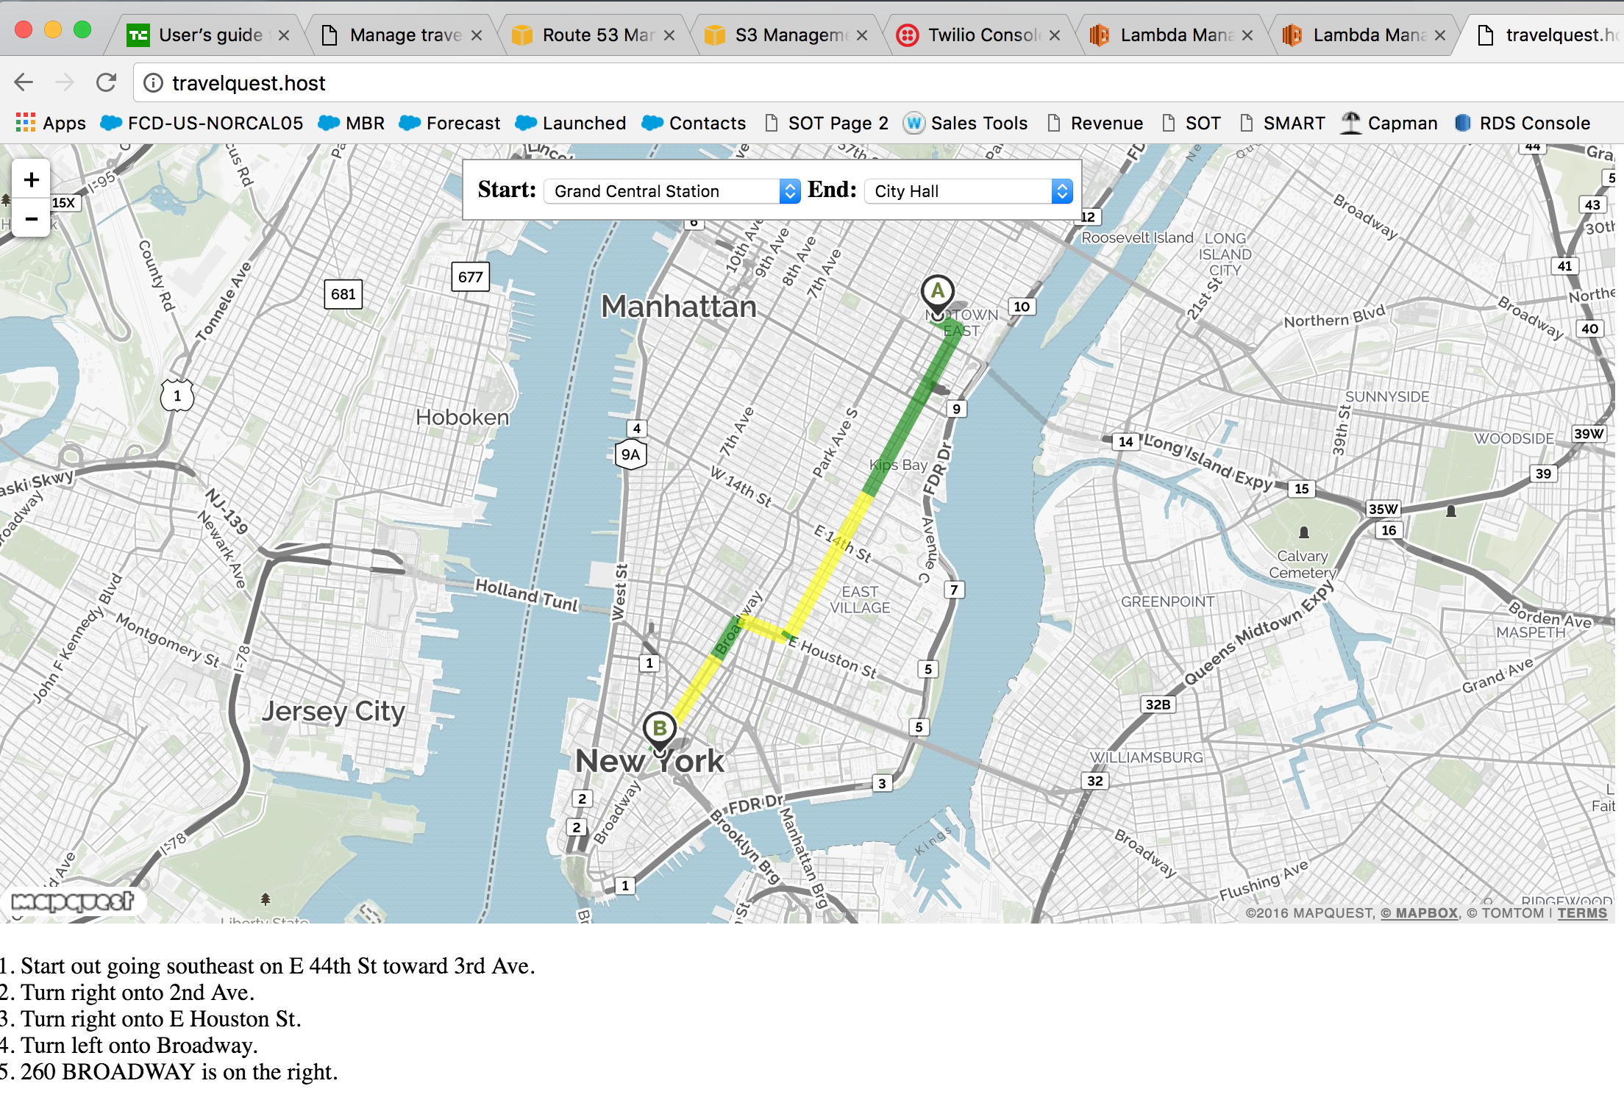
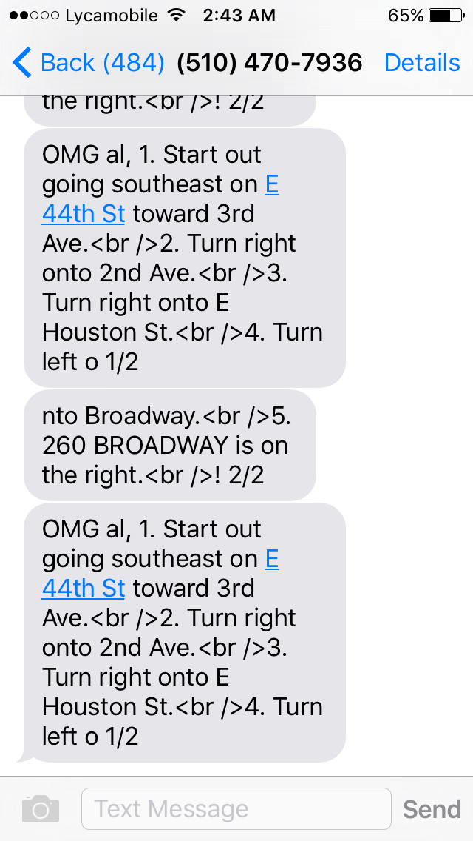
Demo

Slide 7
Architectural aspects
Web application: The website is hosted on AWS S3 static website fronted by Cloudfront content delivery, and Route53 for DNS, with domains provided by Radix. The calls are handled by customer browser js.
Mobile application: Mobile application is directly handled by Twilio. Backend calls are currently made to Mapquest APIs.

Slide 8
Other ideas
Voice call with directions – will be an extension of the Tropo code
Integration with Alexa, Siri, Google to perform advanced features
Integration with Yelp, Foursquare, Google Places etc for location aware and information rich services
Adding voice and text ads for revenue streams

Slide 9
How big is the market?
GSMA Airtime top-up is 3.6% of total mobile transactions which accounted for USD 18.9 B. So airtime top-up value was ~ USD 680 M in Dec15. If we assume international top up is 10% of this market, annual market size is USD 816 M.
Mobile data was 4175 PB/mo globally in 2015

